Slide 1
Customer Loyalty Analysis: Drivers and Customer Segmentation
By
Lakmali Amarawardana

Slide 2
Dataset
Objective
Methods
Customer behaviour (gaming/platform users)
Understand drivers of loyalty points and segment customers
Correlation Analysis, Regression, Decision Tree, K-Means clustering

Slide 3
Objectives
Understand relationship between:
Income
Spending behaviour
Age, education, product
Build predictive models
Create customer segments for marketing
Identify key drivers of loyalty points

Slide 4
Correlations
Strong relationships
Spending score - Loyalty points (0.67) 🔥
Income - Loyalty points (0.62)
Loyalty drivers behaviour + income, not demographics.
Insight
Product -Loyalty points (0.18)
Weak relationships
Age - Loyalty points (-0.04)

Slide 5
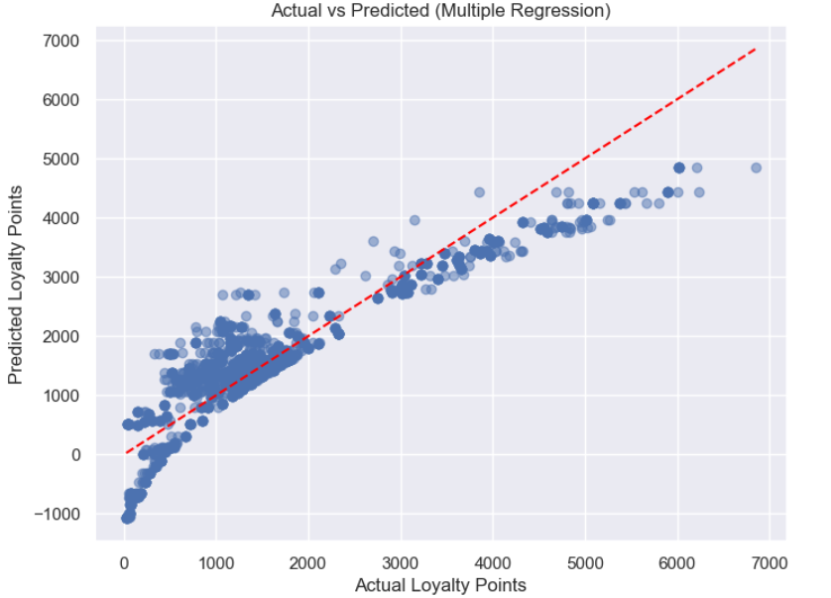
Multiple Linear Regression

Slide 6
Multiple Linear Regression
Model
Target: Loyalty_points
Predictors: income + spending_score
Results
R² = 0.827
F-statistic
Coefficients
Income = 33.98
Spending_score = 32.89
Insight
Both income and spending significantly contribute to loyalty prediction.
p-value = 0.00 (highly significant)

Slide 7
Regression Diagnostics
Residuals
Non-linearity present
Heteroscedasticity present
Normality
Slight skew, acceptable range
Insight
Model assumptions are partially satisfied

Slide 8
🌳Decision Tree Model
Stats
R² = 0.882
Feature importance
Spending → 0.515
Income → 0.483
Insight
Behavioural features dominate prediction (~99%)
RMSE = 440.45

Slide 9
Key Business Insight
Loyalty is primarily behaviour driven
Income is equally important
Demographics have minimal impact

Slide 10
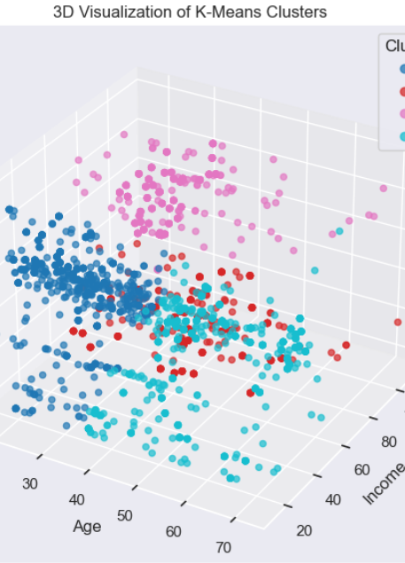
Clustering (K-Means)
k=7 provides better granularity than k=5
Identifies niche behavioural groups
Example clusters:
VIP customers
Low value users
Impulsive low - income Spenders
Wealthy but low engagement

Slide 11
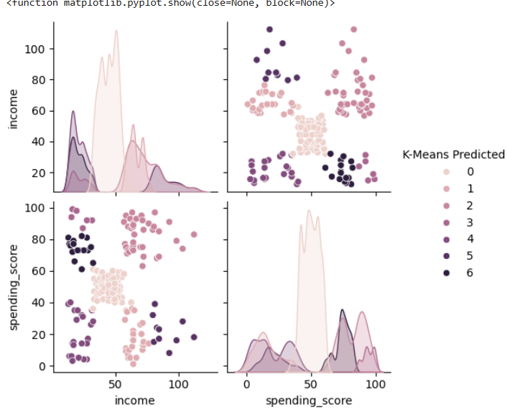
Cluster Behaviour Insight
Even with similar income (12–13 range):
Cluster 4 - Low engagement users
Cluster 6 - High engagement users

Slide 12
Final customer segments
VIP customers high income + high spend
Wealthy but low engagement
Impulsive low- income spenders
Low value customers
Mid segment customers

Slide 13
Conclusion
Loyalty is driven by:
Spending behaviour (strongest)
Income (secondary)
Weak influence:
Age
Education
Product

Slide 14
Message
Customer loyalty is primarily behavioural, not demographic

Slide 15
Recommendations
Target VIP customers with rewards
Re-engage wealthy low-spenders
Design offers for impulsive low-income users
Reduce marketing spend on low-value segment

Slide 16
A mini story! Hard Cluster Boundaries

Slide 17
Customer Segments are Not Always Clear-Cut
Cluster assignment of customers
Located close to boundary
👉 Key issue
Hard (not probabilistic)
Some customers sit very close to multiple segments
Problem
Creates uncertainty at the segment boundaries
Not all customers clearly belong to one segment

Slide 18
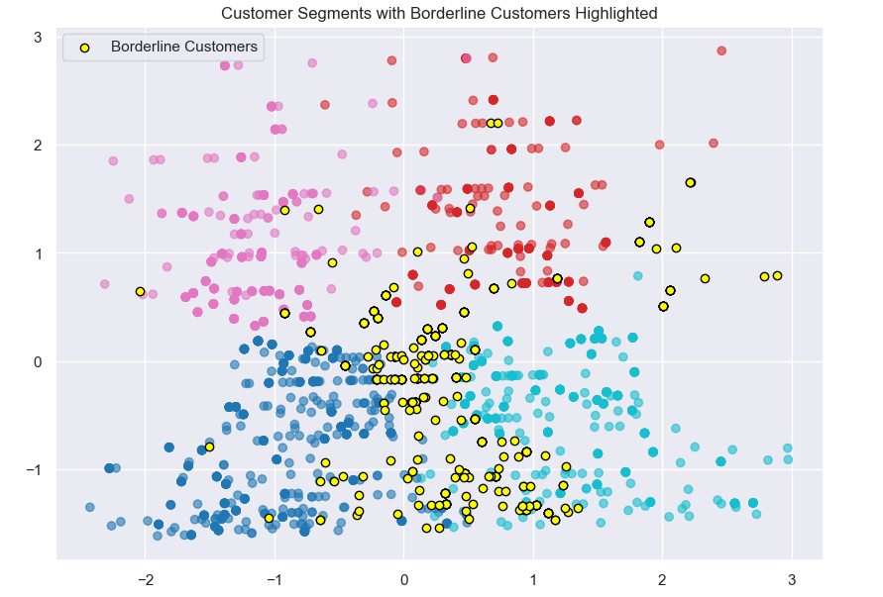
Borderline Customers: Segment Uncertainty
~400 customers are borderline cases
Their assignment is not strongly distinct to one segment

Slide 19
Treat as a monitoring group
~400 customers
Have similar distance to multiple clusters
Show mixed behavioural patterns
Not strongly assigned to one segment
Borderline customers should be
Monitor over time
Track for movement between clusters
Avoid rigid classification decisions

